Slide 1
DIGITAL SYSTEM & BINARY NUMBERS
By :
Abdul Ghofir, M.Kom

Slide 2
Digital System
Digital systems are designed to store, process, and communicate information in digital form.
A computer manipulates information in digital, or more precisely, binary form.
A binary number has only two discrete values — zero or one.
Each of these discrete values is represented by the OFF and ON status of an electronic switch called a transistor.

Slide 3
Binary Digital Signal
Binary values are represented abstractly by:
Digits 0 and 1
Words (symbols) False (F) and True (T)
Words (symbols) Low (L) and High (H)
And words On and Off

Slide 4
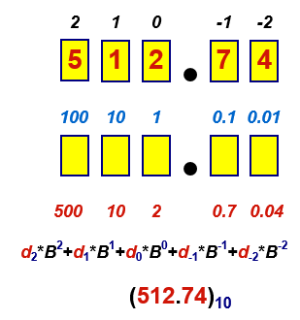
Decimal Number System
Base (also called radix) = 10
10 digits { 0, 1, 2, 3, 4, 5, 6, 7, 8, 9 }
Digit Position
Integer & fraction
Digit Weight
Weight = (Base) ^{Position}
Magnitude
Sum of “Digit x Weight”
Formal Notation

Slide 5
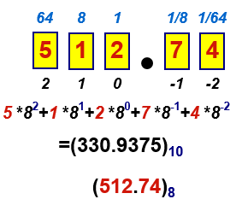
Octal Number System
Base = 8
8 digits { 0, 1, 2, 3, 4, 5, 6, 7 }
Weights
Weight = (Base) ^{Position}
Magnitude
Sum of “Digit x Weight”
Formal Notation

Slide 6
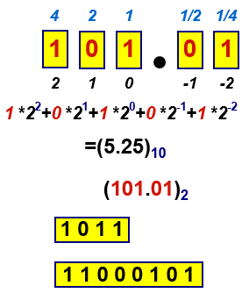
Binary Number System
Base = 2
2 digits { 0, 1 }, called binary digits or “bits”
Weights
Weight = (Base) ^{Position}
Magnitude
Sum of “Bit x Weight”
Formal Notation
Groups of bits 4 bits = Nibble
8 bits = Byte

Slide 7
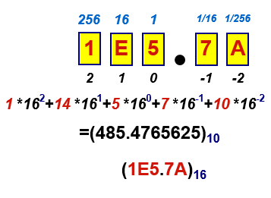
Hexadecimal Number System
Base = 16
16 digits { 0, 1, 2, 3, 4, 5, 6, 7, 8, 9, A, B, C, D, E, F }
Weights
Weight = (Base) ^{Position}
Magnitude
Sum of “Digit x Weight”
Formal Notation

Slide 8
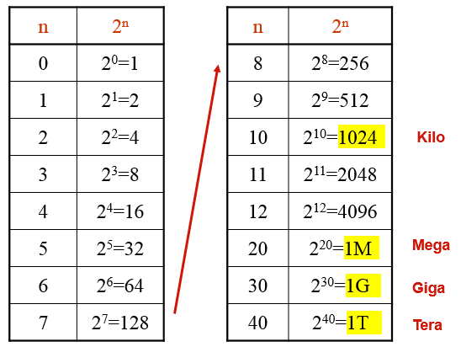
The Power of 2

Slide 9
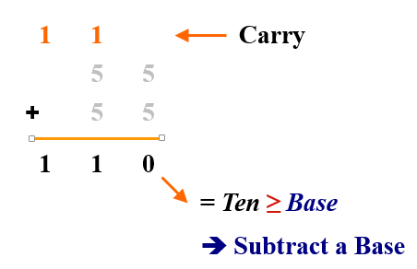
Addition
Decimal Addition

Slide 10
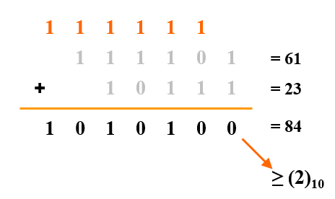
Binary Addition
Column Addition

Slide 11
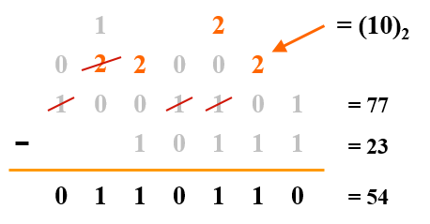
Binary Subtraction
Borrow a “Base” when needed

Slide 12
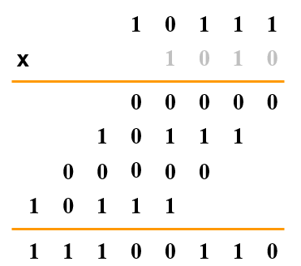
Binary Multiplication
Bit by bit

Slide 13
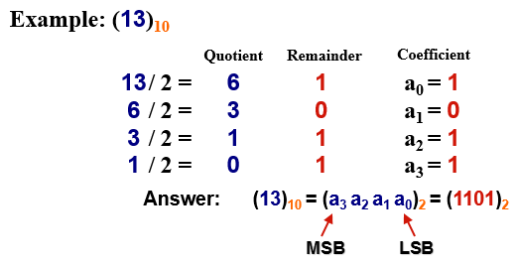
Decimal (Integer) to Binary Conversion
Divide the number by the ‘Base’ (=2)
Take the remainder (either 0 or 1) as a coefficient
Take the quotient and repeat the division

Slide 14
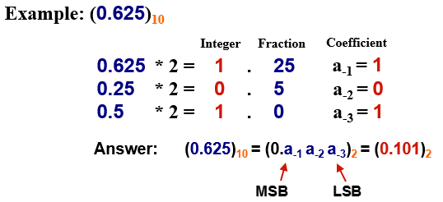
Decimal (Fraction) to Binary Conversion
Multiply the number by the ‘Base’ (=2)
Take the integer (either 0 or 1) as a coefficient
Take the resultant fraction and repeat the division

Slide 15
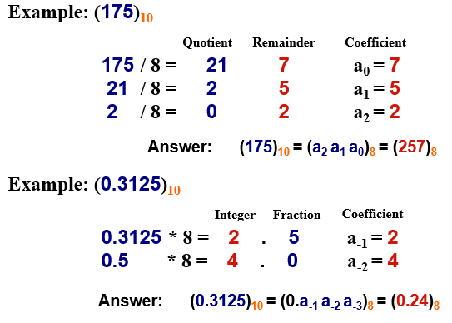
Decimal to Octal Conversion

Slide 16
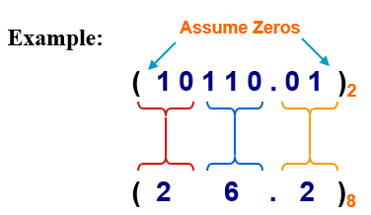
Binary − Octal Conversion
Octal | Binary
0 | 0 0 0
1 | 0 0 1
2 | 0 1 0
3 | 0 1 1
4 | 1 0 0
5 | 1 0 1
6 | 1 1 0
7 | 1 1 1
8 = 2³
Each group of 3 bits represents an octal digit
Works both ways (Binary to Octal & Octal to Binary)

Slide 17
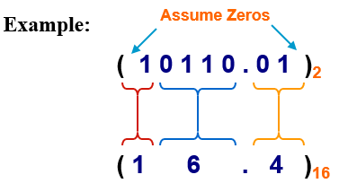
Binary − Hexadecimal Conversion
Hex | Binary
0 | 0 0 0 0
1 | 0 0 0 1
2 | 0 0 1 0
3 | 0 0 1 1
4 | 0 1 0 0
5 | 0 1 0 1
6 | 0 1 1 0
7 | 0 1 1 1
8 | 1 0 0 0
9 | 1 0 0 1
A | 1 0 1 0
B | 1 0 1 1
C | 1 1 0 0
D | 1 1 0 1
E | 1 1 1 0
F | 1 1 1 1
16 = 2⁴
Each group of 4 bits represents a hexadecimal digit
Works both ways (Binary to Hex & Hex to Binary)

Slide 18
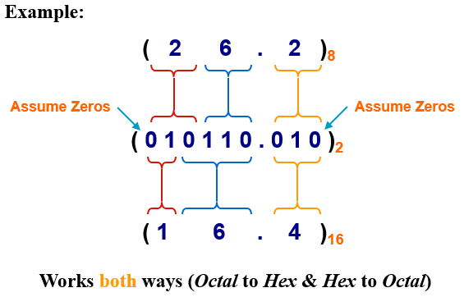
Octal − Hexadecimal Conversion
Convert to Binary as an intermediate step

Slide 19
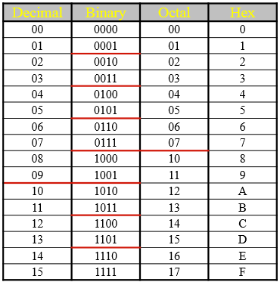
Decimal, Binary, Octal and Hexadecimal

Slide 20
Binary Logic
Definition of Binary Logic
Binary logic consists of binary variables and a set of logical operations.
The variables are designated by letters of the alphabet, such as A, B, C, x, y, z, etc, with each variable having two and only two distinct possible values: 1 and 0,
Three basic logical operations: AND, OR, and NOT.

Slide 21
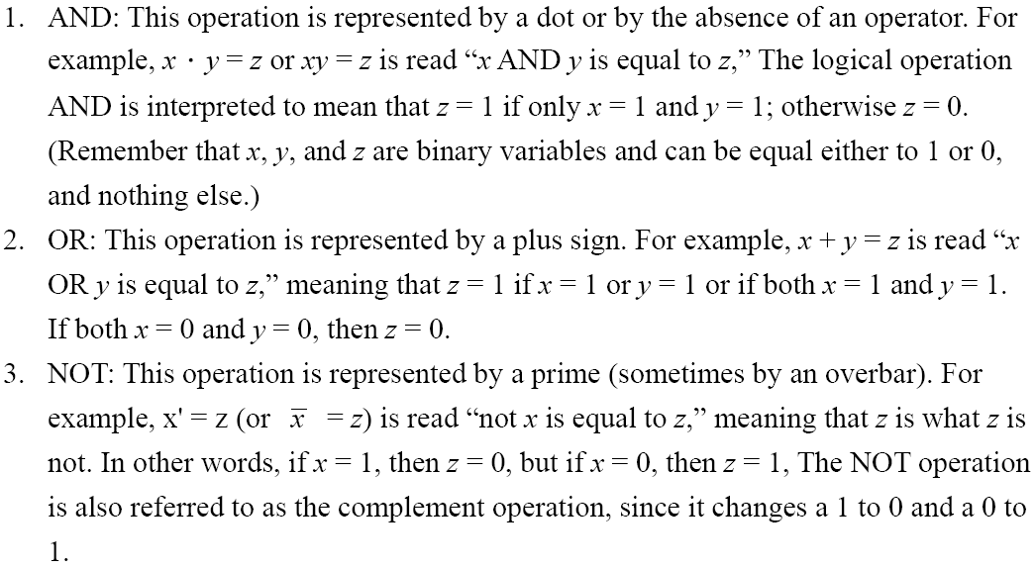
Binary Logic

Slide 22
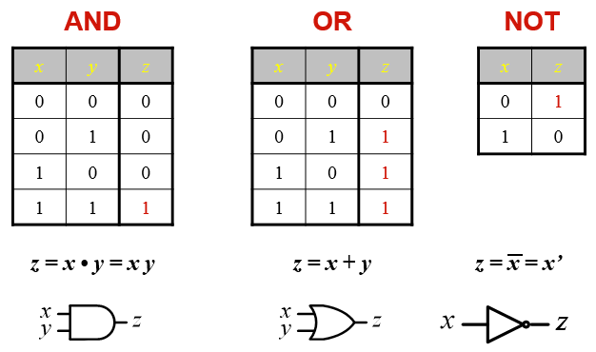
Binary Logic
Truth Tables, Boolean Expressions, and Logic Gates

Slide 23
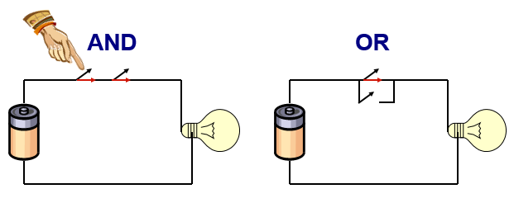
Switching Circuits

Slide 24
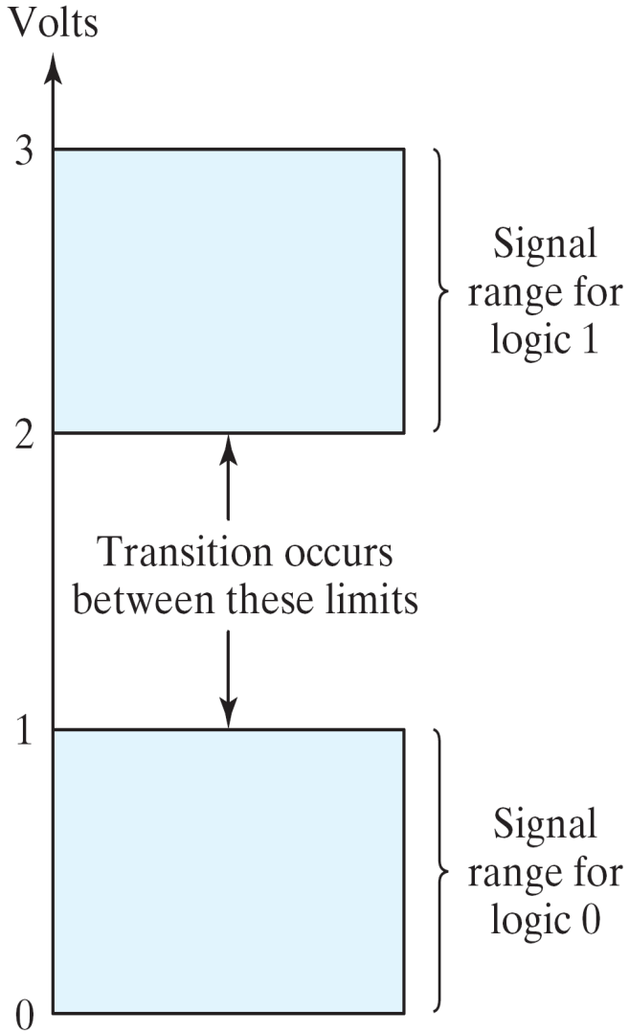
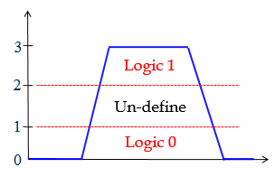
Binary Logic
Logic gates
Example of binary signals

Slide 25
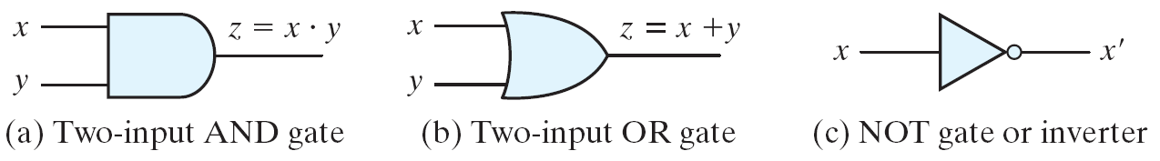
Binary Logic
Logic gates
Graphic Symbols and Input-Output Signals for Logic gates:
Symbols for digital logic circuits

Slide 26
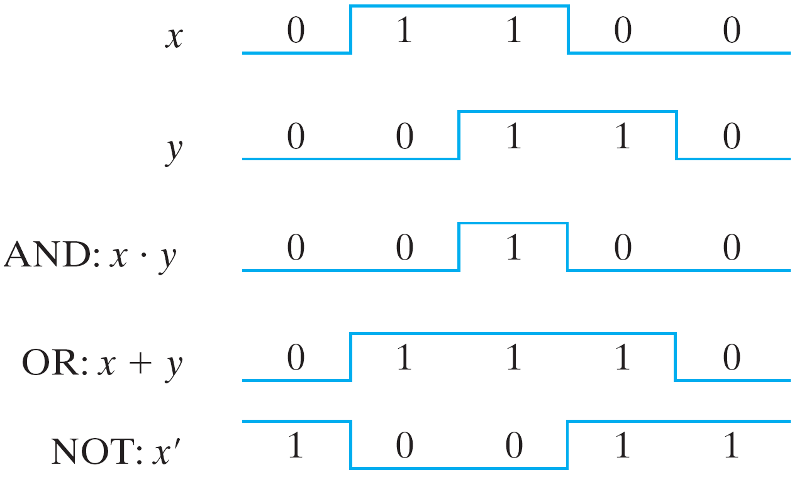
Binary Logic
Logic gates
Graphic Symbols and Input-Output Signals for Logic gates:
Input-Output signals for gates

Slide 27
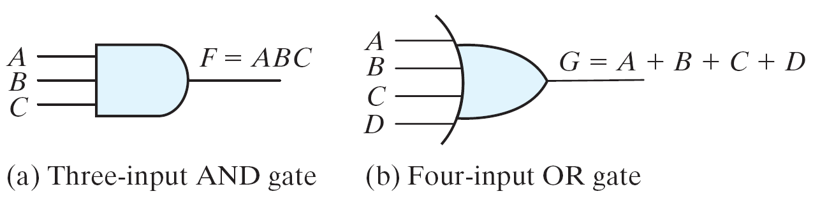
Binary Logic
Logic gates
Graphic Symbols and Input-Output Signals for Logic gates:
Gates with multiple inputs

Slide 28
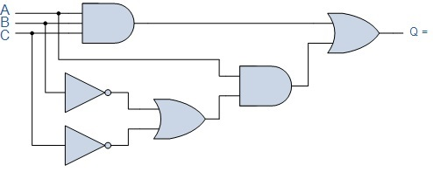
What is the output of Q below?

Slide 29
How is graphic symbol of Q below?
A = 0111, B = 1100, C = 0101

